Slide 1

The Future of Work: A data-driven approach to understanding the job market
TARUSHI GUPTA
HIBA HASSAN

Slide 2
PROJECT MOTIVATION

Slide 3
This data story delves into understanding how AI is not just a buzzword but a transformative force shaping the global job market and entrepreneurial space
As graduate students, navigating the current job market and questioning ideal roles and our motivations, this becomes a pertinent study

Slide 4
The Data
Artificial Intelligence Job Openings*
Identifying AI-related job opportunities globally and in the USA.
The Top 1000 Companies*
Analyzing companies and industries that offer AI-related job openings.
Investigating correlations between company growth, revenue, and AI job opportunities.
Main Datasets Used
Career Path Selection Challenges*
Emphasizing the significance of targeted skillsets in career decisions.
Exploring factors that influence career path selection.
Notes:
*Share of artificial intelligence jobs among all job postings: Our World In Data https://ourworldindata.org/grapher/share-artificial-intelligence-job-postings
* USA States data - https://www.census.gov/geographies/mapping-files/time-series/geo/carto-boundary-file.html
*Top 1000 Companies: Kaggle - https://www.kaggle.com/datasets/amritpal24/top-1000-companies-details
*Career Path Selection Survey: Kaggle - https://www.kaggle.com/datasets/mtalhazafar/career-path-selection-challenges

Slide 5
Themes & Questions
AI Adoption in the USA & Decentralization of Tech Hubs
How has the AI job market evolved over the years?
Where are the AI Technology Hubs?
Within the USA, which states are emerging as new hubs for AI job opportunities?
The AI Employment
Landscape
Metrics for growth
Influence of Investors &
Accelerator Programs
Is there any correlation between the growth of a company vs. the number of employees and its growth vs. estimated revenues?
How many of these AI companies reached a billion-dollar valuation? And who are these?
Which industries do these companies primarily belong to?
The Innovation
Landscape
Personal Motivations
Behind Career Choices
How does one navigate through their career path?
How do knowledge and skills influence career choices?
Navigating your
Career Path
Notes:
Let's take another look at the provided content and extract the exact questions that were posed in each section:
AI Adoption and Its Global Footprint:
How has the AI job market evolved over the years, and which countries are leading this growth?
Within the USA, which states are emerging as new hubs for AI job opportunities?
Beyond the Tech Giants:
Who are these companies offering more AI-related job roles in specific regions?
Is there any correlation between the growth of a company vs. the number of employees and its growth vs. estimated revenues?
Unraveling the Relationship Between Employees, Revenues, and Growth:
Is there any correlation between the growth of a company vs. the number of employees and its growth vs. estimated revenues?
Is there a correlation between job opportunities and estimated revenues?
AI Startup Valuations:
How long does it take for startups to reach a billion-dollar valuation?
How many of these AI companies reached a billion-dollar valuation? And who are these?
Which industries do these companies primarily belong to?
The Drivers Behind Career Choices:
How does one navigate through their career path?
How do knowledge and skills influence career choices?

Slide 6
KEY FINDINGS

Slide 7
Key Findings
AI Adoption in the USA:
USA dominates the expanding global AI job market, with unexpected growth surges in countries like Spain and new AI hubs emerging in states like Virginia and Florida.
Decentralization of Tech Hubs:
Smaller cities are catching up with traditional tech hubs, and startups are achieving billion-dollar valuations within just 5-7 years of their inception.
Analyzing Metrics for Growth:
Startups exhibit varied growth patterns, with no direct correlation between company growth and employee count or revenues, hinting at diverse business and expansion strategies.
Influence of Investors and Accelerator Programs:
Certain investors have a stellar record in nurturing AI startups to billion-dollar valuations, while accelerator programs don't always guarantee heightened market values.
Personal Motivations Behind Career Choices:
Career choices are deeply influenced by personal passions and previously acquired skills, emphasizing the significance of introspection and self-awareness in one's professional journey.

Slide 8
THE JOURNEY

Slide 9

THE AI EMPLOYMENT LANDSCAPE
Notes:
Dibing into the AI employment landscape,

Slide 10
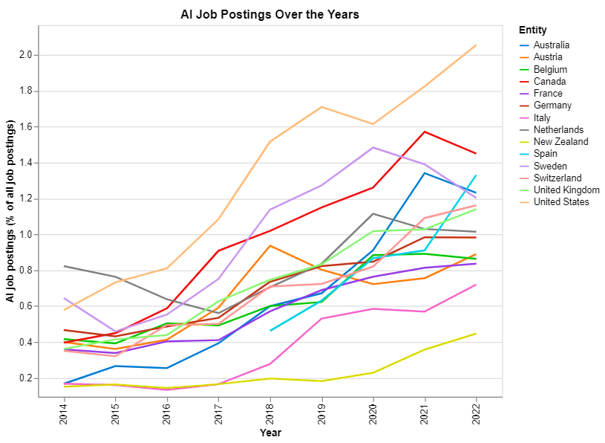
How has the AI job market evolved over the years?
Where are the AI technology hubs?
Since 2014, the number of job openings in the field of AI has experienced a substantial increase in countries worldwide, representing a growing trend in the demand for
AI-related positions.
Top Hubs(2022)
USA
Canada
Spain
Australia
Italy
Notes:
We want to know how has the AI job market evolved over the years and where are these ai hubs?
Since 2014, AI-related job openings have been on a steady rise signifying a growing need for AI-driven skills across various industries.
United States has been the fastest growing AI Job Market with the largest share of AI roles since 2015, and more so on the rise since after the pandemic. Meanwhile, Canada saw a decline along with Australia and a steeper decline for Sweden.
The most dramatic growth in the percentage of AI roles has been in Spain from 2021 to 2022. Similar results have also been found through different [studies](https://lightcast.io/resources/blog/global-ai-skills-jobs).

Slide 11
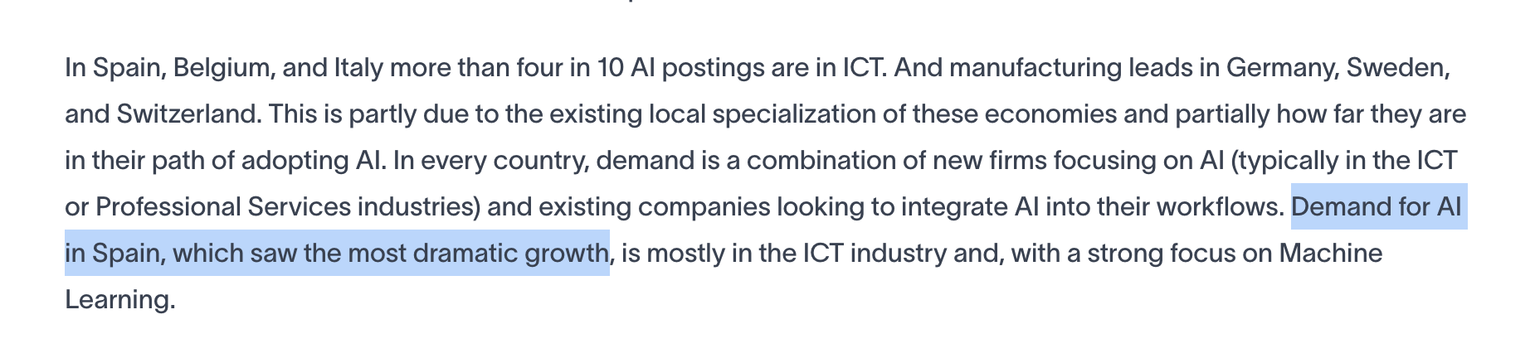
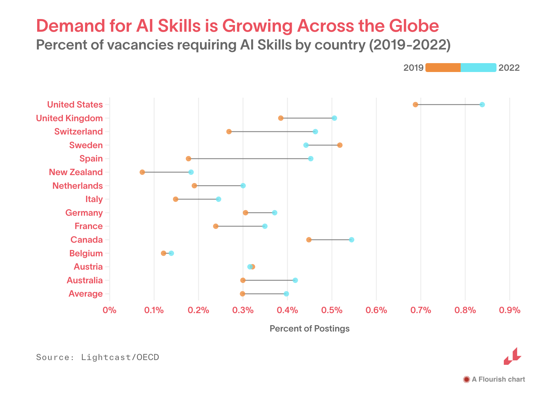
Source: https://lightcast.io/resources/blog/global-ai-skills-jobs
Notes:
The most dramatic growth in the percentage of AI roles has been in Spain from 2021 to 2022. Similar results have also been found through different [studies](https://lightcast.io/resources/blog/global-ai-skills-jobs).

Slide 12
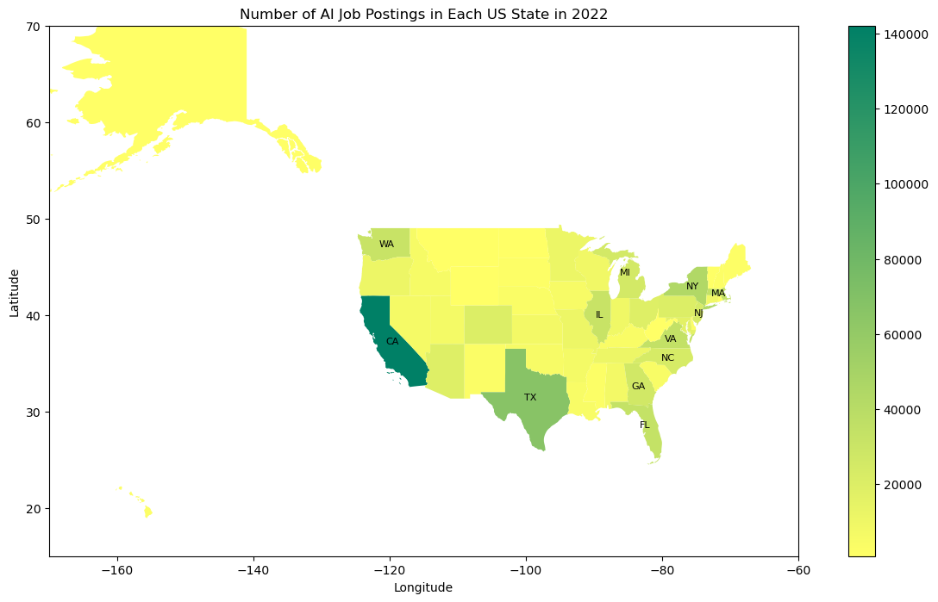
Which states are emerging as new AI hubs?
California, Texas, New York, and Massachusetts have been AI hubs
We discover that states like Virginia, Florida, Illinois, and Washington are experiencing a surge in AI job openings.
Notes:
Our exploration begins with a look at AI job postings beyond the well-known tech giants.
While California, Texas, New York, and Massachusetts have been AI hubs, we discover that states like Virginia, Florida, Illinois, and Washington are experiencing a surge in AI job openings. This regional distribution sets the stage for our broader examination.

Slide 13
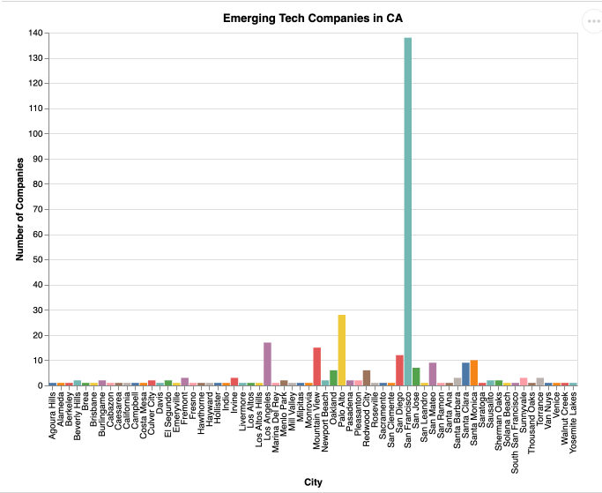
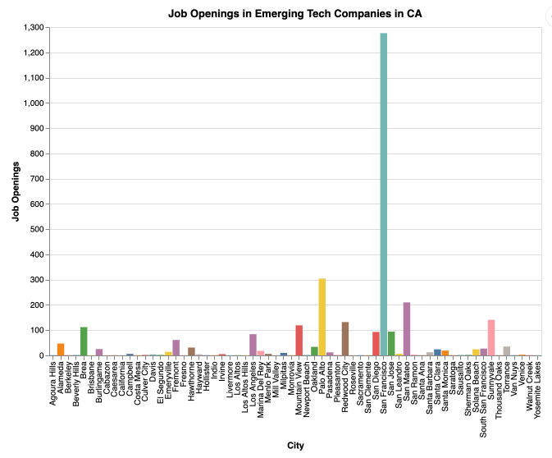
Beyond the Tech Giants
Notes:
With interest in learning more about startups, we are exploring the top_1000 companies dataset (created in the Spring of 2023, also avilable on kaggle)) from the growjo platform.
The chart you see visualizes the number of companies and job openings in the state of california. This graph hints at something interesting. San Mateo has fewer companies than lets say San Diego or Mountain view, but it has more number of job openings.

Slide 14
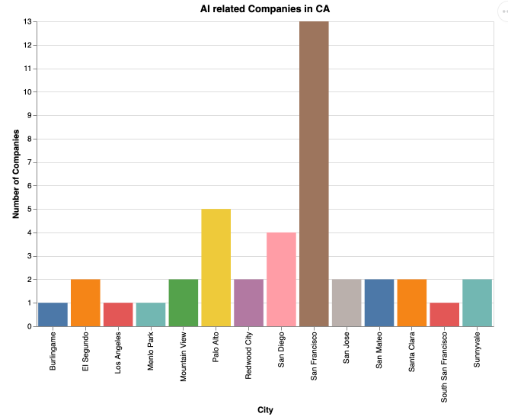
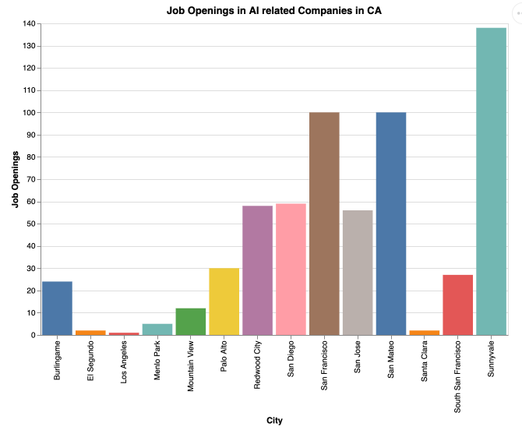
California: More AI related job roles in Sunnyvale and San Mateo (that have fewer AI companies) vs Mountain View, San Diego or Palo Alto (that have relatively more AI companies)
Notes:
These graphs focus on AI comapnies. There are more AI related job roles in Sunnyvale and San Mateo (even though they have fewer AI companies) vs Mountain View, Sand Diego or Palo Alto which have relatively more AI companies).

Slide 15
AI Adoption in the USA & Decentralization of Tech Hubs
Key Findings
AI job openings have consistently surged worldwide since 2014, reflecting an increasing demand for AI-related roles.
USA dominates the expanding global AI job market, with unexpected growth surges in countries like Spain and new AI hubs emerging in states like Virginia and Florida.
Smaller cities are catching up with traditional tech hubs
Notes:
Understanding th erAI adoption in the usa and the decentralization of tech hubs, we came out with the follwing key takea ways.

Slide 16
THE INNOVATION LANDSCAPE
Notes:
Moving onto nderstanfing the innovation landscape,

Slide 17
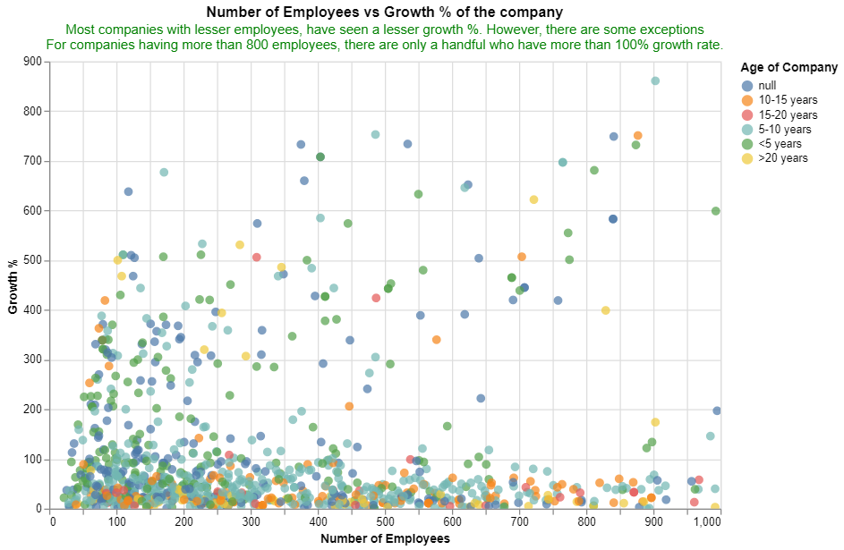
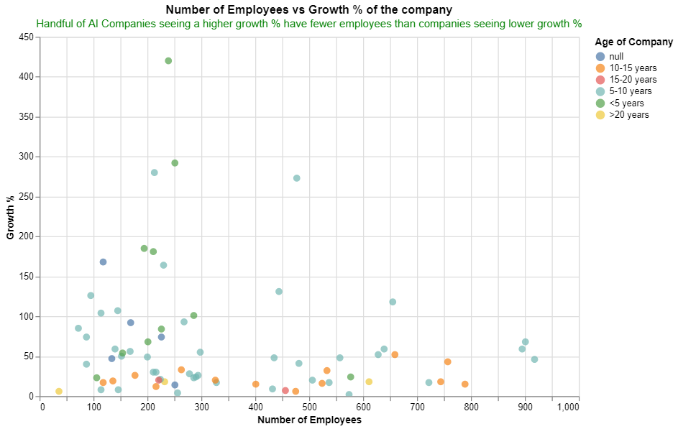
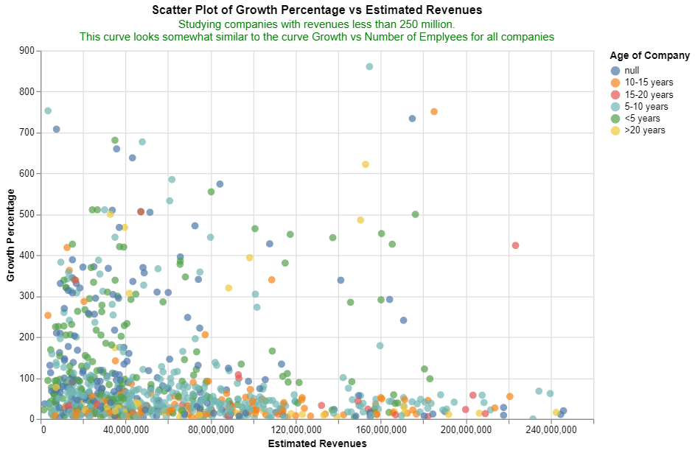
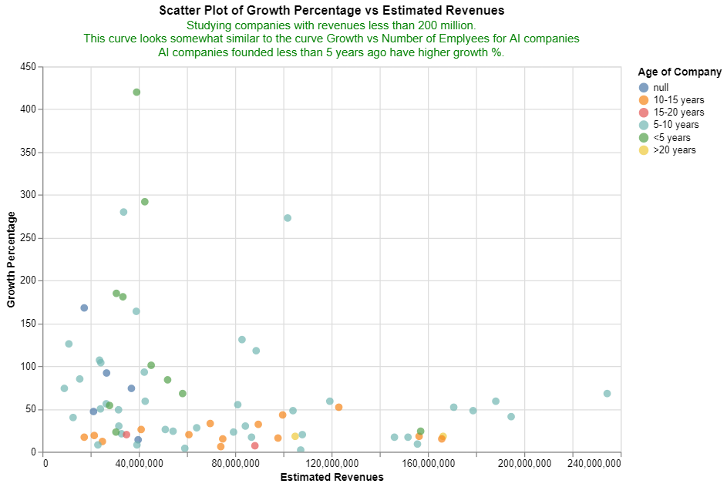
Is there any correlation between growth of a company vs
the number of employees / growth vs estimated revenues?
Notes:
We want to know if there are any Is there any correlation between growth of a company vs
the number of employees / growth vs estimated revenues?
From the charts on the left, we can see that most companies with lesser employees and lesser revenues, see a lesser growth %.
However, there are some exceptions. For companies having more than 800 employees, there are only a handful who have more than 100% growth rate.
By just eyeballing the graph, it might look like there is some positive correlation between employee count vs growth, however the correlation is insignigficant to confidentally to make any comment.
AI companies founded less than 5 years ago have higher growth % and a smaller employee count.
This supports the fact that companies grow faster in their initial years and their growth slows down later down the line and have a very small workforce initially.

Slide 18
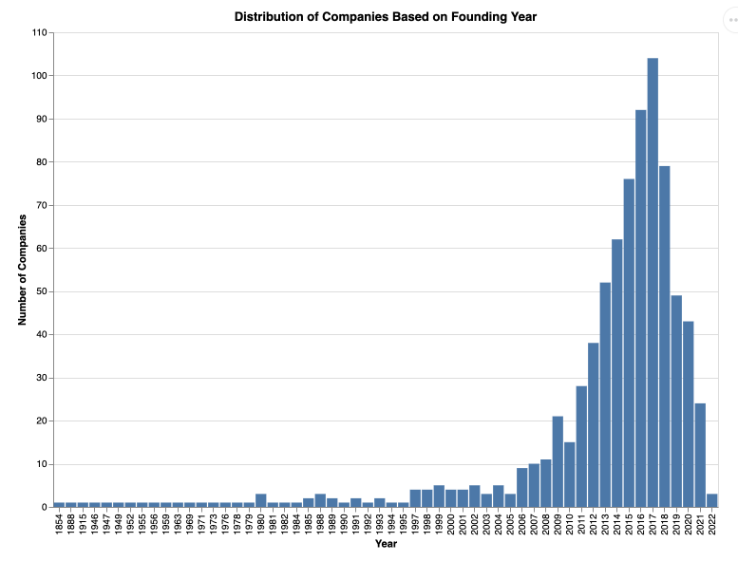
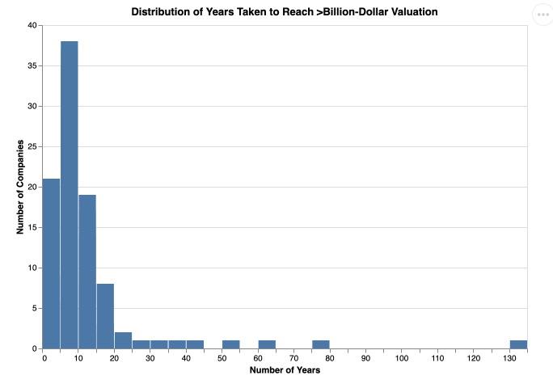
How many AI companies reached a billion-dollar valuation?
Notes:
To evaluate how many AI companies reached billion dollar valuation, we first understood when were these companies founded.
- A majority of the companies took between 0 to 10 years to reach the billion-dollar valuation mark.
- There's a noticeable spike for companies that took around 5-7 years.
- Few companies took longer, in the range of 20-60 years, indicating more traditional businesses or those that experienced significant growth after an extended period.
This distribution reflects the rapid scaling and growth of many modern startups and tech companies, which can achieve substantial valuations within a relatively short time span.

Slide 19
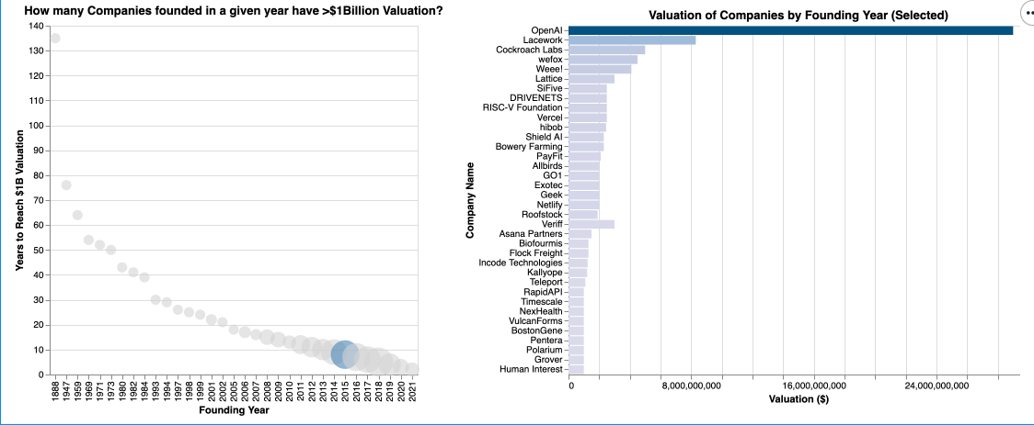
How many AI companies reached a billion-dollar valuation?
Notes:
As an example, many of the companies founded in 2015, 2016 are now billion dollar companies. Some of these have revolutionized the world through emerging tech - the biggest example being OpenAI.

Slide 20
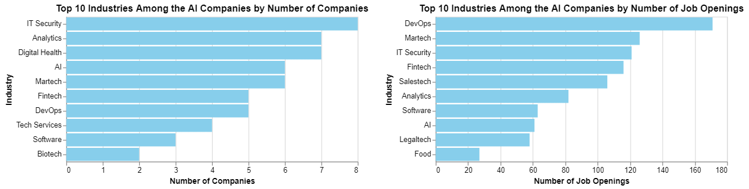
What Industries is the AI space made of?
Notes:
Moving on, which industries are quickly adopting AI?
IT Security, Analytics and Digital Health have the highest number of AI companies, whereas there are more AI roles in DevOps, followed by Marketing Technology, IT Security and FinTech.
Companies in industries like IT Security, DevOps, FinTech, Marketing Technology, Analytics, AI, and Software could be good to target for future employment seekers.
These industries seem to be adapting AI and also looking to increase their AI-skilled workforce.

Slide 21
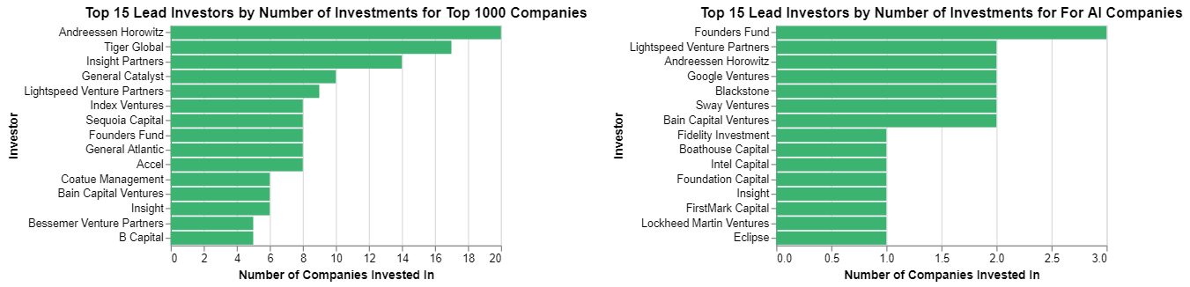
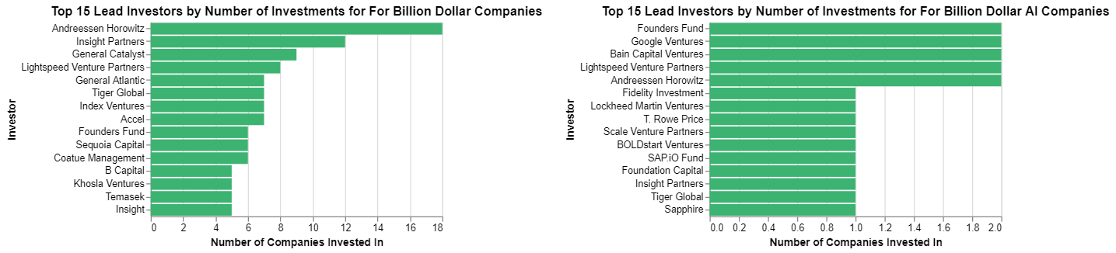
Who are the lead investors in these companies?
Notes:
For startups, investors are the backbone of their financial standing. Out of curiosity, we wanted to know who these investors are.
The two charts on the left show that the top investors are creating billion dollar companies.
On the right we see that the top investors in AI companies are also creating Billion Dollar AI Companies.
Interestingly, Lightspeed Venture Partners, Google Ventures, Andreessen Harowitz, Bain Capital Ventures have a 100% rate of converting AI companies to Billion dollar AI Companies. They are selective in who they fund. Similarly, more investors with 100% conversion rate exist in the data.

Slide 22
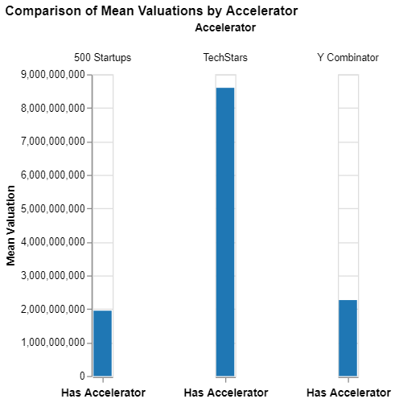
Do accelerator programs make a significant difference in the valuations of AI companies?
Notes:
Another interesting question that came to our mind was understanding if accelerator programs make a significant difference in valuation of AI companies.
Our expectation was that companies that have undergone accelerator programs would have higher valuations. Instead, there seems to be no significant difference. This maybe due to data limitation. This could be also be due to different type of accelerator program that the company is enrolled in and also be affected by the different stage of funding they may be in.
Also, from the accelerators who did invest in these emerging companies, what did the mean valuation between them looked like. Investments made by TechStars seems to be having higher mean valuations than 500 Startups and Y Combinator. Due to lack of data, any comment for AI specific companies cannot be made.

Slide 23
Metrics for Growth
Influence of Investors & Accelerator Programs
Higher growth/revenues do not necessarily mean higher job openings
Higher revenues in AI-focused companies don't guarantee more job openings. Additionally, for startups, higher revenues may correlate with reduced growth, raising questions about the factors driving their valuations.
Key Findings
Certain investors have a stellar record in nurturing AI startups to billion-dollar valuations, while accelerator programs don't always guarantee heightened market values..

Slide 24
NAVIGATING YOUR CAREER PATH

Slide 25
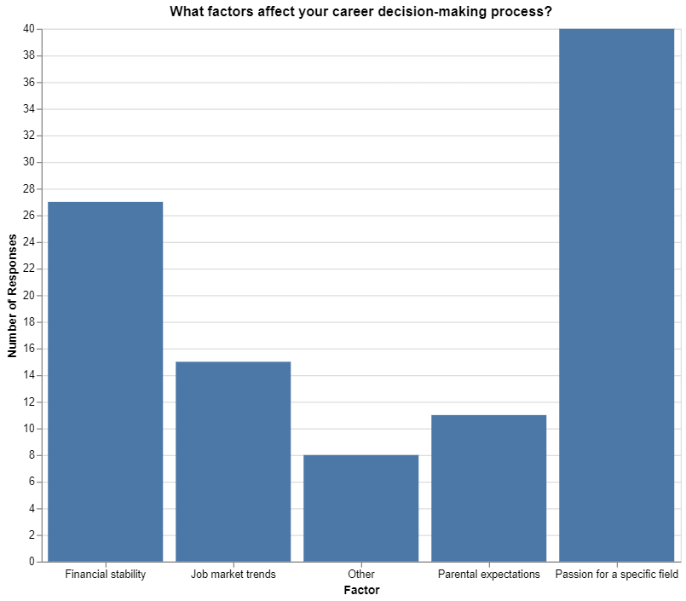
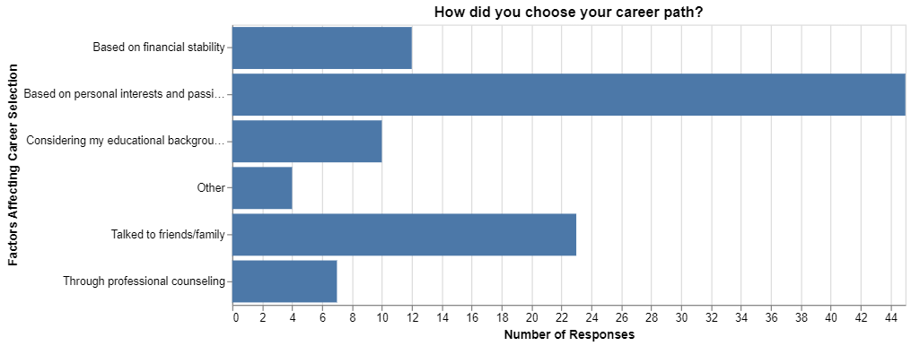
How to navigate career choices?
Beyond financial incentives and market trends, it was their genuine passion and interest in their field of work that held the most value while deciding their career path.

Slide 26
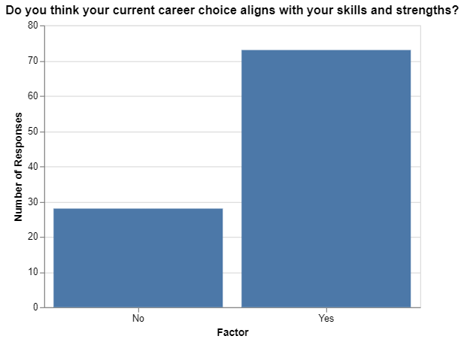
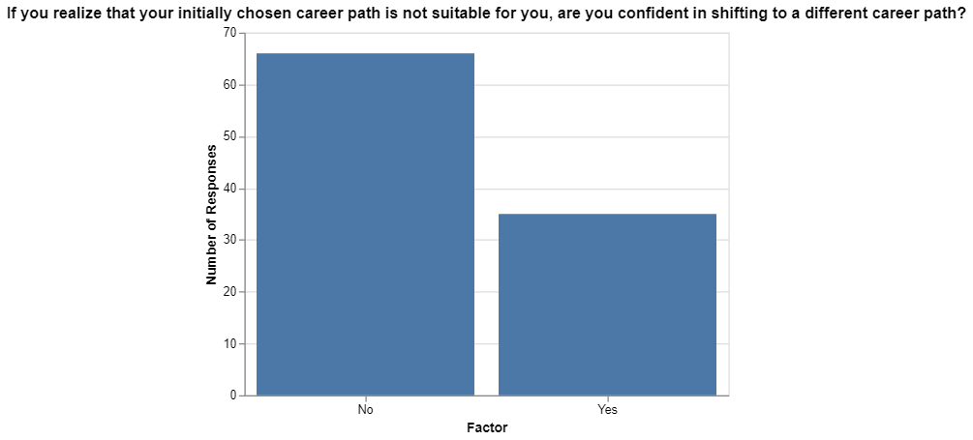
How do knowledge and skills influence career choices?
Career choices are primarily influenced by the skills individuals have already acquired, with less emphasis on skills not yet attained. Individuals are often reluctant to pursue career paths that require skills learned on the job.

Slide 27
How to navigate career choices?
Key Findings
Career choices are dictated by personal interests and passions, with secondary emphasis on financial stability and market trends.
Acquiring career-specific skill sets is key in defining one’s career journey which emphasizing the significance of introspection in the new-age job seeker.
Notes:
As graduate students, we are exploring the motivations behind our career choices, whether they are primarily influenced by external factors or intrinsic ones. Our goal is to identify the driving forces behind our career journeys.
To accomplish this, we utilized a dataset from a survey conducted at The Islamia University of Bahawalpur, Punjab, Pakistan, which is available on Kaggle. This dataset provides insights into the challenges students face when selecting their career paths and how these challenges impact their academic pursuits. While the dataset is relatively small, our analysis also highlights the significance of having more extensive global data on this subject.

Slide 28
SO, WHAT SHOULD YOU DO?

Slide 29
Some Questions to ask yourself.
Self Reflection
What are my true passions?
What specific skill sets are essential for pursuing a career in my chosen field?
Is there a growing demand for professionals in my field of interest?
Should I target startups or established corporations based on my preferences?
Which companies align with my career goals? Do they offer relevant job opportunities and exhibit growth?
Do these companies have investments or partnerships with billion-dollar firms?

Slide 30
THANKYOU
TARUSHI GUPTA
HIBA HASSAN

